Slide 1
Math's Behind Regularization
To handle overfitting problem

Slide 2
Regularization:
Regularization is a technique used to prevent overfitting in machine learning models by penalizing large weights in the model.
Large weights can cause the model to fit the training data too closely, capturing noise and leading to poor generalization on unseen data.
Regularization works by adding a penalty term to the loss function, which discourages large weights.

Slide 3
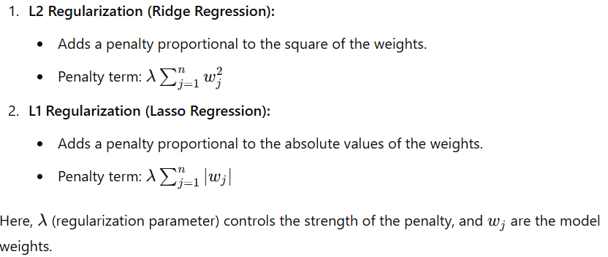
Types of Regularization:

Slide 4
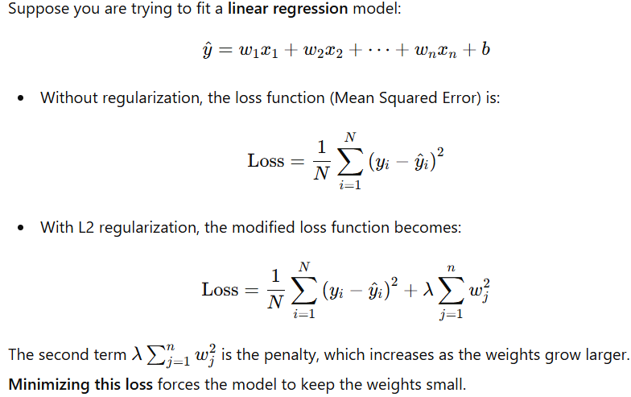
L2 Regularization: Ridge Regression

Slide 5
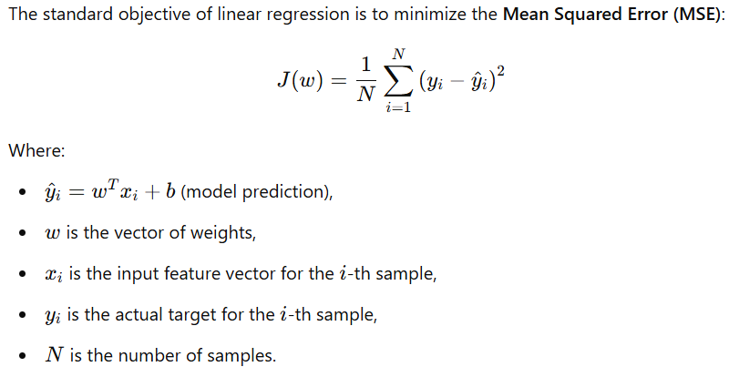
Linear Regression (No Regularization)

Slide 6
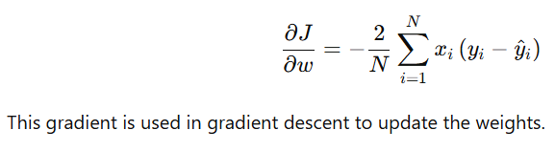
Gradient of J(w):
The gradient of J(w) with respect to the weights w is:

Slide 7
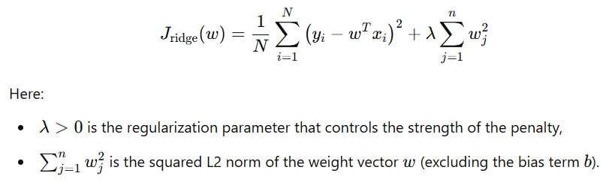
L2 Regularization (Adding Penalty)
To penalize large weights, we add an L2 regularization term to the loss function.
The new objective becomes:

Slide 8
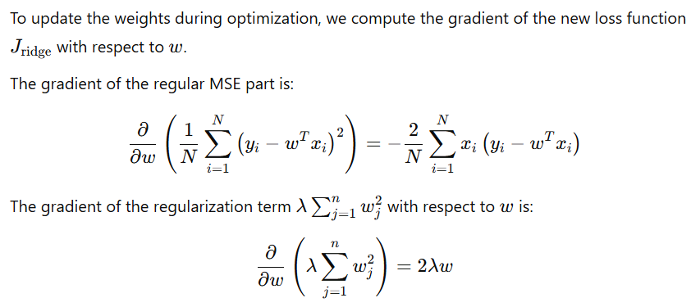
Math's behind L2 Regularized Loss: Gradient loss

Slide 9
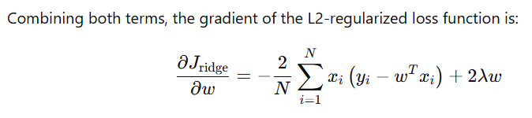
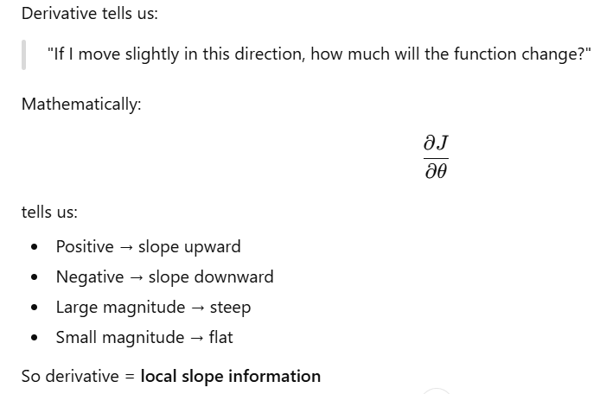

Slide 10
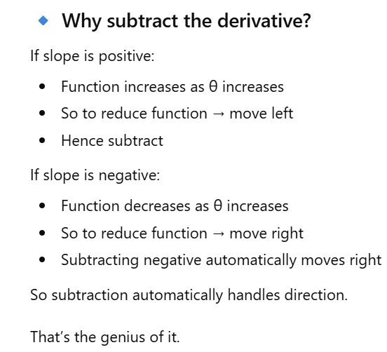

Slide 11
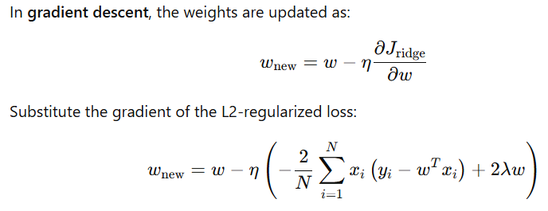
Effect of Regularization on Weight Update

Slide 12
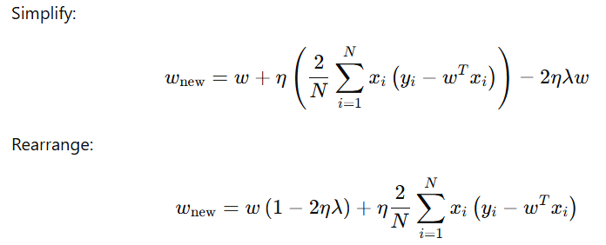

Slide 13
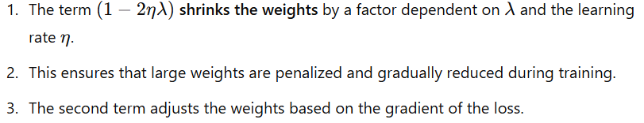
Interpretation

Slide 14
Numerical Example
Assume:
A single input feature x,
Initial weight w=10,
Learning rate η=0.1,
Regularization parameter λ=0.5,
Gradient of the loss (without regularization) is −4.

Slide 15
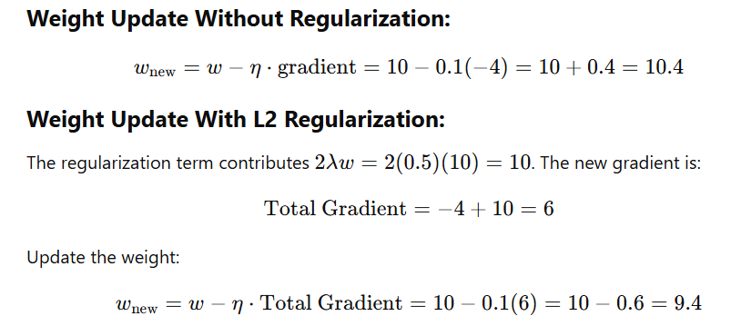

Slide 16
